Slide 1

Interpreting Deep Learning Models in Natural Language Processing
Tongxiang Lu
May 8th, 2023

Slide 2
Introduction
Deep learning models have revolutionized various domains, such as computer vision, natural language processing(NLP), speech recognition, and so on (Collobert et al., 2011; Goldberg, 2016).
In this presentation, we will focus on the application of deep learning in NLP with wide-ranging applications such as text classification, machine translation, and sentiment analysis.

Slide 3
Literature Review
Methodology:
Relevant Google Scholar articles , R and Python code are used.
The research terms included "Word embeddings," "RNN," and "Transformer".
A comparative analysis of the different deep learning models and algorithms are used in NLP.

Slide 4
Algorithms application in NLP
Word embeddings
Word2Vec, have gained popularity due to their ability to analyze semantic similarity between words.
Recurrent Neural Networks (RNNs)
A popular choice for many NLP tasks due to their ability to manage sequential data.
Transformers
Transformer-based models, have revolutionized the field of NLP
& achieved state-of-the-art performance on various NLP tasks.

Slide 5
Advantages and Disadvantages of Algorithms
Word embeddings
Advantages: high precision rate of analyzing semantic similarity between words & relatively low computational cost
Disadvantages: cannot handle phrases or sentences.
RNNs
Advantages: good at managing sequential data Disadvantages: have vanishing gradients and slow convergence.
Transformers
Advantages: achieve state-of-the-art performance on various NLP tasks,
Disadvantages: require more computing power and training time.

Slide 6
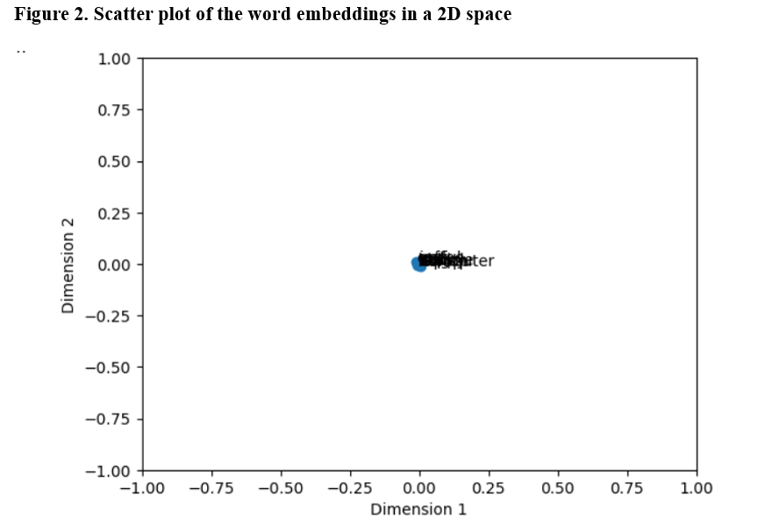
Word Embeddings Illustration
Note: Word2Vec captures the semantic similarity between words in the sample corpus.

Slide 7
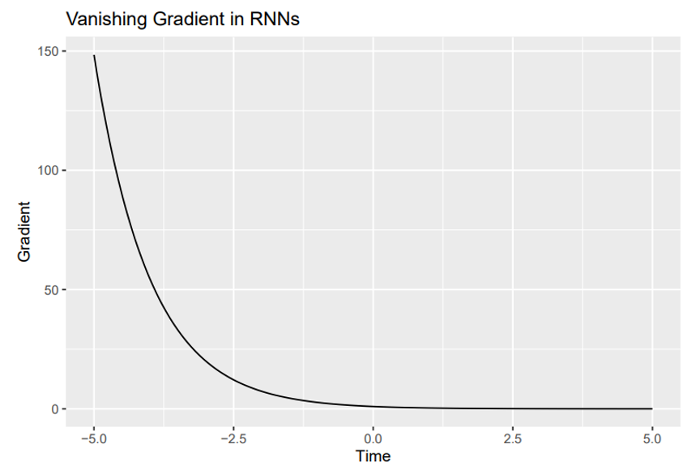
Recurrent Neural Networks (RNNs)
Note: Except for their limitations, RNNs still remain a popular choice for many NLP tasks due to their ability to manage sequential data.

Slide 8
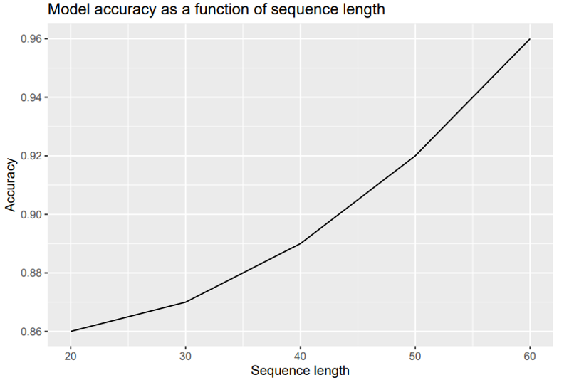
Transformers
Note: the accuracy of the transformer-based model improves when the sequence length increases.

Slide 9
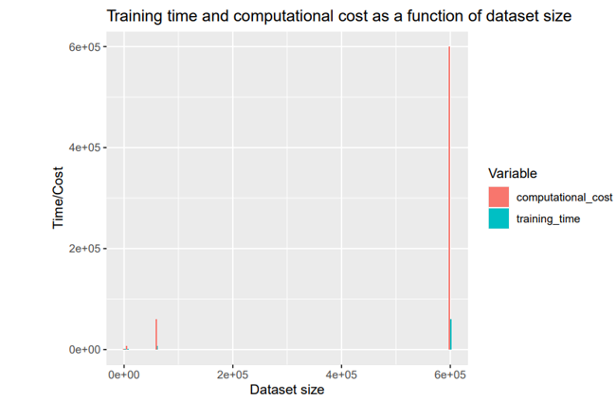
Transformers
Note: the training time and computational cost of transformer-based models increase significantly with the size of the dataset.

Slide 10
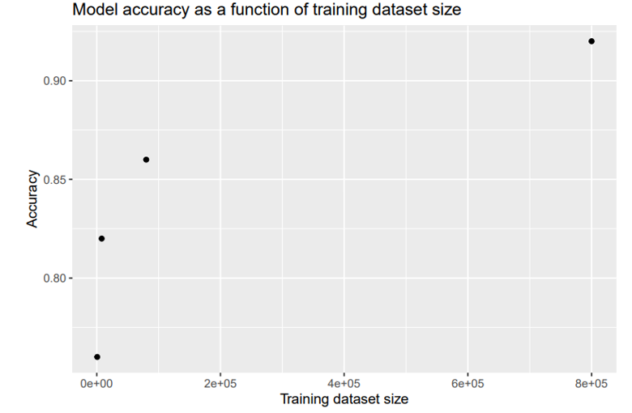
Transformers
Note: As highlighted in recent studies, this limitation(a small amount of training) can result in biased models that perform poorly on certain groups or topics, leading to discrimination and exclusion.

Slide 11
Current Deep Learning Applications in Industries
Current Deep Learning Applications in Healthcare
Predict disease progression & recommend treatment plans in clinical decision support systems
(Rajkomar et al., 2018).
Current Deep Learning Applications in Transportation
Recognize objects, detect pedestrians, and predict other vehicles' behavior (Bojarski et al., 2016).
Current Deep Learning Applications in Security
Video surveillance and facial recognition also utilize deep learning models

Slide 12
Challenges and Limitations
Challenges and limitations
Lack of interpretability & insufficient generalization.
Future research
1. Combining deep learning with other machine learning techniques 2. Adversarial attacks and privacy concerns

Slide 13
Conclusion
Deep learning models have revolutionized natural language processing, but there are still challenges and limitations.
By conducting a systematic review of the literature on deep learning for NLP and analyzing the performance of different models on various datasets, more interpretable deep learning models for NLP tasks can be enhanced to apply in various industries.

Slide 14
References
Bojarski, M., Del Testa, D., Dworakowski, D., Firner, B., Flepp, B., Goyal, P., ... & Zieba, K. (2016). End to end learning for self-driving cars. arXiv preprint arXiv:1604.07316.
Collobert, R., Weston, J., Bottou, L., Karlen, M., Kavukcuoglu, K., & Kuksa, P. (2011). Natural language processing (almost) from scratch. Journal of Machine Learning Research.
Gal, Y., Islam, R., & Ghahramani, Z. (2017, July). Deep bayesian active learning with image data. In International conference on machine learning (pp. 1183-1192). PMLR.
Rajkomar, A., Oren, E., Chen, K., Dai, A. M., Hajaj, N., Hardt, M., ... & Dean, J. (2018). Scalable and accurate deep learning with electronic health records. NPJ digital medicine, 1(1), 18.

Slide 15
Thank You!

